Slide 1
Ultrasonic Sensor Pilotless Vehicle
ECE 4309.01 Fundamental of Cybersecurity
Armando castro - William chu - harutun minasyan - youssef youssef

Slide 2
Objectives
Build a ultrasonic system for a remote pilotless vehicle
SSH into the Raspberry Pi
Intercept the data going from the Pi using Hercules
Capture the packets through Wireshark
Interpret the data from Wireshark

Slide 3
Step
An Arduino board collects data from the ultrasonic sensors on the vehicle.
This data is then sent to a Raspberry Pi via a bus system.
On the Raspberry Pi, the data is handled by I2C serial bus
You can use SSH via PuTTY (a remote login application) from a Windows machine to access the Raspberry Pi.
Once the data is recorded by Hercules and Wireshark, it is then displayed on the output box of Hercules and we will then use Wireshark to verify the connection was recorded and read and analyze the tcp stream.

Slide 4

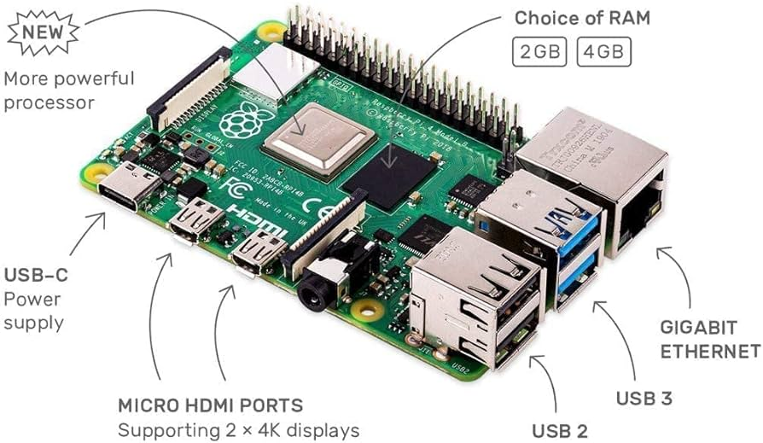
Procedure - Raspberry Pi
The data collected by the Arduino is sent to a Raspberry Pi via a bus system. The Raspberry Pi, a small and affordable computer, is used for more complex processing. It receives the ultrasonic sensor data from the Arduino for further analysis.
On the Raspberry Pi, a specific program processes the incoming data. This program might be performing tasks such as filtering the data, making decisions based on the sensor inputs, or preparing the data for further analysis.

Slide 5
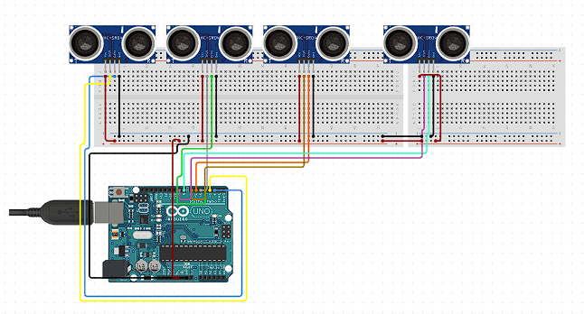
Procedure - Arduino
Built an ultrasonic sensor system on my SDP
Able to report with 50ms delay
Used the SDA and SCL port to connect to I2C serial bus
Implemented with the autonomous mode to stop when there is an object in front of the kart

Slide 6
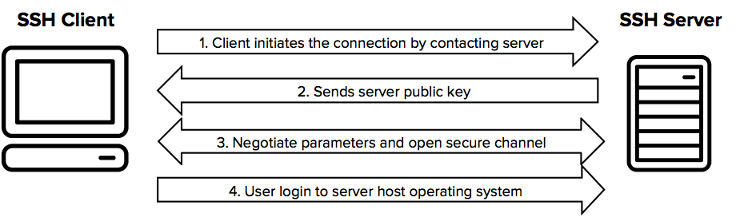
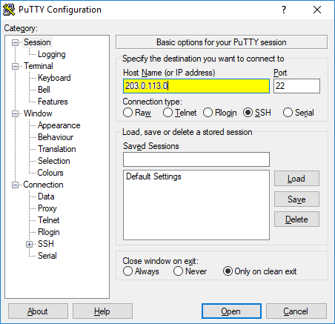
Procedure - SSH
PuTTY is a versatile and widely-used terminal emulator program for Windows, known primarily for its ability to establish secure SSH (Secure Shell) connections and its user-friendly interface. It's particularly popular for creating SSH tunnels, which are encrypted channels used for secure data transfer and remote server access. When you use PuTTY for SSH tunneling, you're essentially setting up a protected pathway through which data can be transferred securely between your local machine and a remote server.

Slide 7
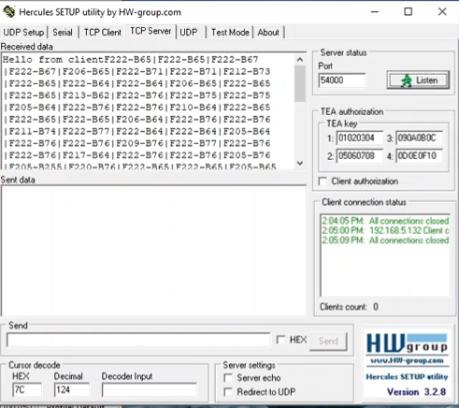
Procedure – Hercules
Hercules is a free utility tool used to set up client server terminals for UDP, TCP, and IPs.
Create an TCP server environment using the IP and serial port required.
When directly linked to the specified port, there will be a series of pings that the port will respond to.
The readings given are from the pigpio(I2C data)

Slide 8
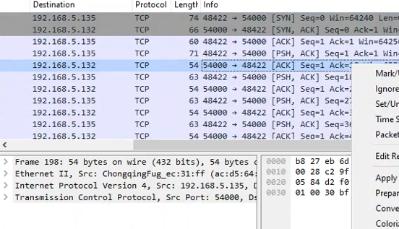
Procedure – Wireshark
Using Wireshark, we can look through and check to verify that the tcp data is coming in through the network
We can find the data by looking for the port we SSHed into (port 54000)
We are also simultaneously recording this data are able to use the pcap file produced by Wireshark to further analyze and/or share the data we extracted later

Slide 9
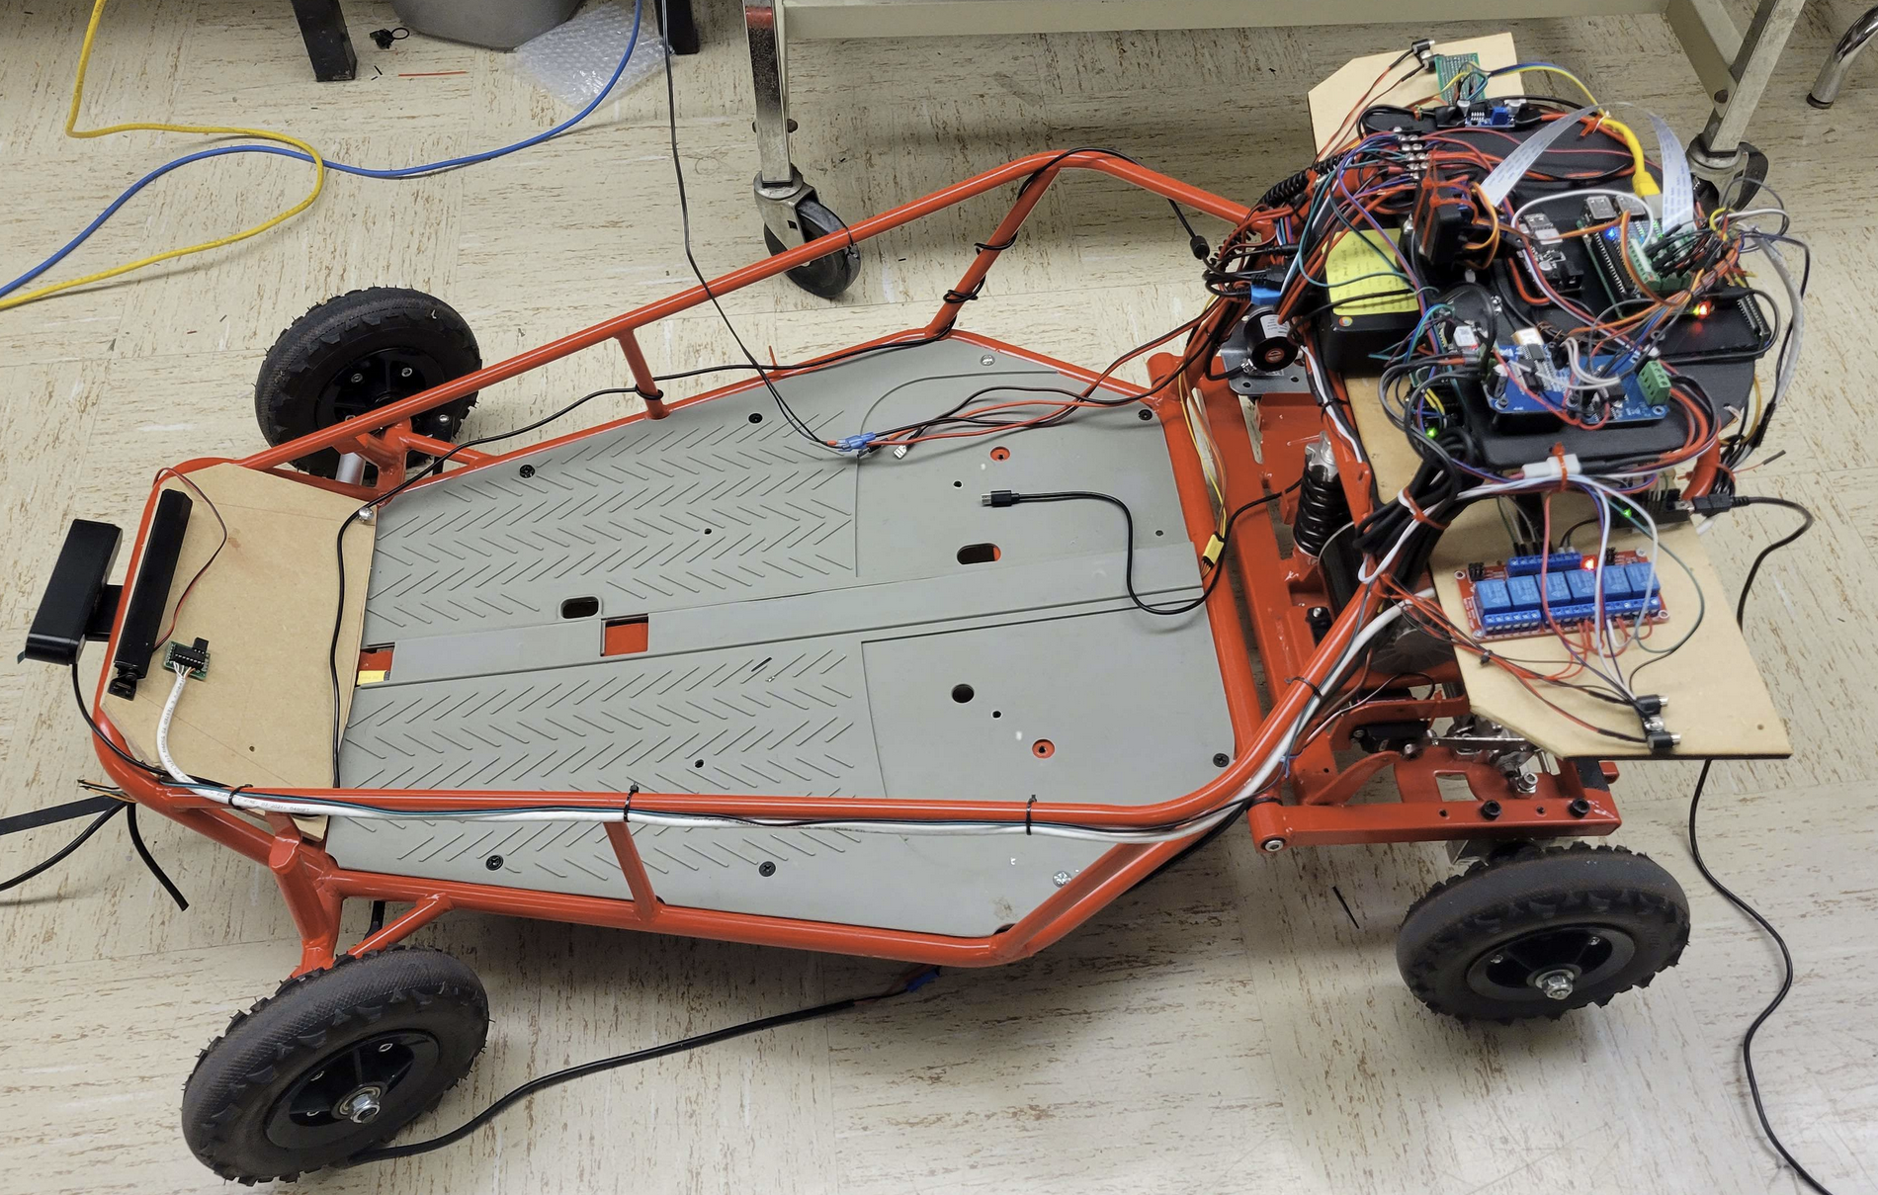
Challenges
Thin wires were not reporting correct distances
Fried multiple Arduinos
Faulty ultrasonic sensors

Slide 10
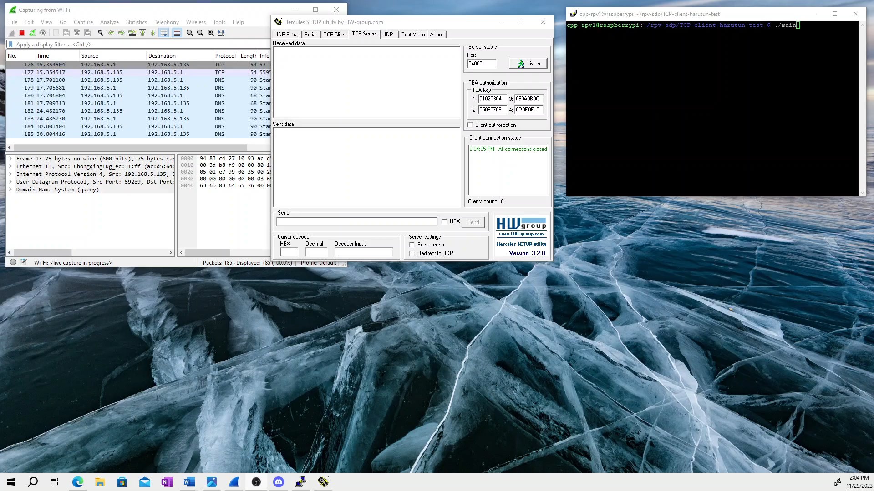
Results

